Slide 1
Microservices
Chapter 6

Slide 2
Agenda
By the end of this chapter, you will learn:
The basic concept of autoscaling and different approaches for autoscaling
The importance and capabilities of a life cycle manager in the context of microservices
Examining the custom life cycle manager to achieve autoscaling
Programmatically collecting statistics from the Spring Boot actuator and using it to control and shape incoming traffic

Slide 3
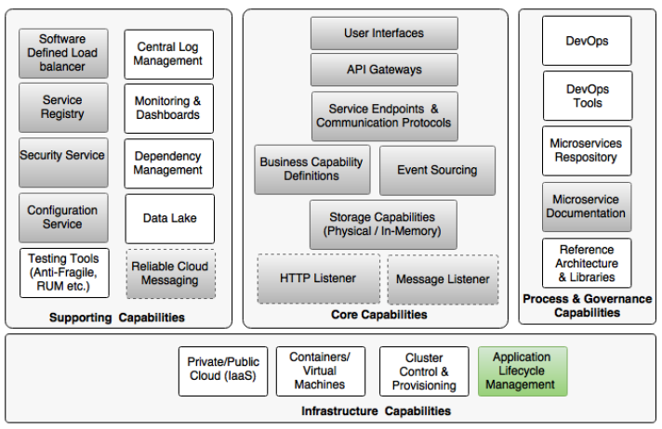
microservice capability model

Slide 4
Scaling microservices with Spring Cloud
Old Approach: (Clustering Approach)
In JEE application servers, the server instances' IP addresses are more or less statically configured in a load balancer
That’s why cluster approach is not the best solution for automatic scaling in Internet-scale deployments
Clusters have to have exactly the same version of binaries on all cluster nodes.
Failure of one cluster node can poison other nodes due to the tight dependency between nodes

Slide 5
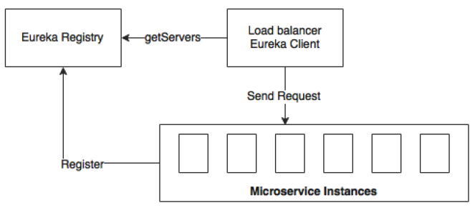
Scaling microservices with Spring Cloud
New Approach: (Registry Approach)
The registry approach decouples the service instances
It eliminates the need to manually maintain service addresses in the load balancer or configure virtual IPs
Notes:
There are three key components in our automated microservices deployment topology:
1- Eureka is the central registry component for microservice registration and discovery. REST APIs are used by both consumers as well as providers to access the registry. The registry also holds the service metadata such as the service identity, host, port, health status, and so on.
2- The Eureka client, together with the Ribbon client, provide client-side dynamic load balancing. Consumers use the Eureka client to look up the Eureka server to identify the available instances of a target service. The Ribbon client uses this server list to load-balance between the available microservice instances. In a similar way, if the service instance goes out of service, these instances will be taken out of the Eureka registry. The load balancer automatically reacts to these dynamic topology changes.
3- The third component is the microservices instances developed using Spring Boot with the actuator endpoints enabled.

Slide 6
Problems with this approach?
When there is need for an additional microservice instance, a manual task is required to kick off a new instance
Notes:
When a service is IDLE, a separate task is needed to be taken out of services to have optimal infrastructure usage.
This is especially relevant when services un on a pay-as-per-usage cloud environment.

Slide 7
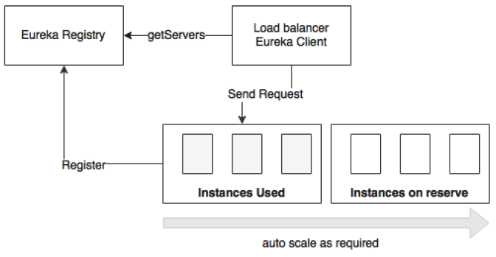
Understanding the concept of autoscaling
Autoscaling is an approach to automatically scaling out instances based on the resource usage to meet the SLAs by replicating the services to be scaled
This approach is often called elasticity
It is also called dynamic resource provisioning and deprovisioning.
Notes:
The system automatically detects an increase in traffic, spins up additional instances, and makes them available for traffic handling.
Similarly, when the traffic volumes go down, the system automatically detects and reduces the number of instances by taking active instances back from the service.
Autoscaling is an effective approach specifically for microservices with varying traffic patterns.
example:
an Accounting service would have high traffic during month ends and year ends. There is no point in permanently provisioning instances to handle these seasonal loads
In the autoscaling approach, there is often a resource pool with a number of spare instances. Based on the demand, instances will be moved from the resource pool to the active state to meet the surplus demand

Slide 8
Why autoscaling ?
In traditional deployments, administrators reserve a set of servers against each application
This prefixed server allocation may result in underutilized servers.
Idle servers cannot be utilized even when neighboring services struggle for additional resources.
Pre-allocating a fixed number of servers to each of the microservices is not cost effective.

Slide 9
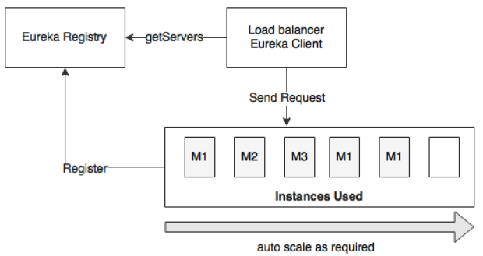
Benefits of Autoscaling
With autoscaling, server pre-allocation is no longer required
Microservices can be dynamically moved across the available server instances by optimally using the resources:
Notes:
How to gain most benefit from autoscaling:
Reserve a number of server instances for a group of microservices without pre-allocating or tagging them against a microservice.
Instead, based on the demand, a group of services can share a set of available resources.

Slide 10
Benefits of Autoscaling
It has high availability and is fault tolerant
even if one service fails, another instance can take over and continue serving clients
It increases scalability:
Horizontal scalability.
Autoscaling allows us to selectively scale up or scale down services automatically based on traffic patterns
It has optimal usage and is cost saving
instances will be started and shut down based on the demand.
resources are optimally utilized, thereby saving cost
Notes:
How to gain most benefit from autoscaling:
Reserve a number of server instances for a group of microservices without pre-allocating or tagging them against a microservice.
Instead, based on the demand, a group of services can share a set of available resources.

Slide 11
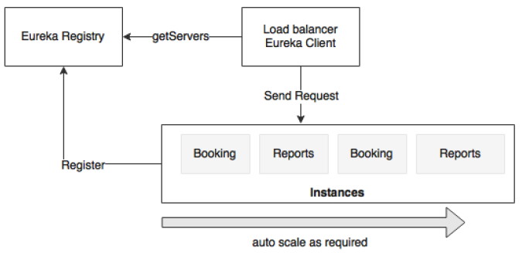
Benefits of Autoscaling
It gives priority to certain services or group of services:
it is possible to give priority to certain critical transactions over low-value transactions.
will be done by removing an instance from a low-value service and reallocating it to a high-value service
will eliminate situations where a low-priority transaction heavily utilizes resources when high-value transactions are cramped up for resources
Notes:
How to gain most benefit from autoscaling:
Reserve a number of server instances for a group of microservices without pre-allocating or tagging them against a microservice.
Instead, based on the demand, a group of services can share a set of available resources.
For instance, the Booking and Reports services run with two instances, as shown in the preceding diagram. Let's assume that the Booking service is a revenue generation service and therefore has a higher value than the Reports service. If there are more demands for the Booking service, then one can set policies to take one Reports service out of the service and release this server for the Booking service.

Slide 12
Different autoscaling models
Application Level Autoscaling
scaling by replicating application binaries only
Infrastructure Level Autoscaling
replicating the entire virtual machine, including application binaries.

Slide 13
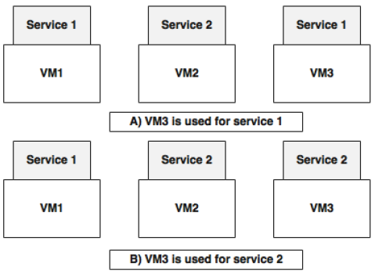
Autoscaling Application
The assumption is that there is a pool of VMs or physical infrastructures available to scale up microservices. These VMs have the basic image fused with any dependencies, such as JRE.
It is also assumed that microservices are homogeneous in nature. This gives flexibility in reusing the same virtual or physical machines for different services:
Notes:
In the diagram, two scenarios: Scenario A, Scenario B.
Difference, we only swapped the application library and not the underlying infrastructure
This approach gives:
1- faster instantiation as we are only handling the application binaries and not the underlying VMs.
2- The switching is easier and faster as the binaries are smaller in size and there is no OS boot required either
The downside of this approach is:
1- that if certain microservices require OS-level tuning or use polyglot technologies, then dynamically swapping microservices will not be effective.

Slide 14
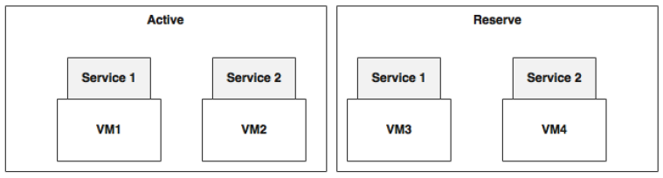
Autoscaling the infrastructure
Automatic Provisioning
In most cases, create new VM on the fly or destroy the VMs based on the demand
Here, the reserve instances are created as VM images with predefined service instances.
Notes:
This approach is efficient if:
1- the applications depend upon the parameters and libraries at the infrastructure level, such as the operating system. 2- Also, this approach is better for polyglot microservices.
The downside is
1- The heavy nature of VM images and the time required to spin up a new VM.
2- Lightweight containers such as Dockers are preferred in such cases instead of traditional heavyweight virtual machines

Slide 15
Autoscaling in the cloud
Cloud providers use infrastructure scaling patterns that are typically based on a set of pooled machines
Notes:
For example, in AWS, these are based on introducing new EC2 instances with a predefined AMI.
AWS supports autoscaling with the help of autoscaling groups. Each group is set with a minimum and maximum number of instances. AWS ensures that the instances are scaled on demand within these bounds.
In case of predictable traffic patterns, provisioning can be configured based on timelines.
AWS also provides ability for applications to customize autoscaling policies.
Microsoft Azure also supports autoscaling based on the utilization of resources such as the CPU, message queue length, and so on.
IBM Bluemix supports autoscaling based on resources such as CPU usage
----------------------------------------------------------------------------------------------------------------------------------------------------
Pivotal Cloud Foundry (Paas) supports autoscaling with the help of Pivotal Autoscale. Scaling policies are generally based on resource utilization, such as the CPU and memory thresholds
Other PaaS platforms, such as CloudBees and OpenShift, also support autoscaling for Java applications
----------------------------------------------------------------------------------------------------------------------------------------------------
Netflix Fenzo, Eucalyptus, Boxfuse, and Mesosphere are some of the components that run on top of the cloud and provide fine- grained controls to handle autoscaling

Slide 16
Autoscaling approaches
Scaling with resource constraints
Scaling during specific time periods
Scaling based on the message queue length
Scaling based on business parameters
Predictive autoscaling

Slide 17
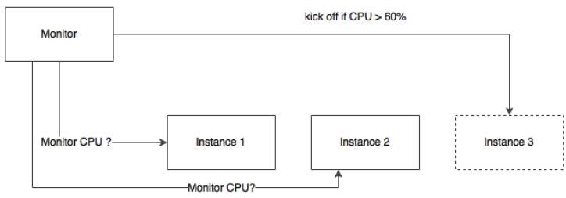
Scaling with resource constraints
This approach is based on real-time service metrics collected through monitoring mechanisms.
takes decisions based on the CPU, memory, or the disk of machines.
takes decisions based on looking at the statistics collected on the service instances themselves, such as heap memory usage.
Examples:
response sliding window
CPU sliding window
exception sliding window
Notes:
A typical policy may be spinning up another instance when the CPU utilization of the machine goes beyond 60%.
Similarly, if the heap size goes beyond a certain threshold, we can add a new instance.
The same applies to downsizing the compute capacity when the resource utilization goes below a set threshold. This is done by gradually shutting down servers
In typical production scenarios, the creation of additional services is not done on the first occurrence of a threshold breach.
The most appropriate approach is to define a sliding window or a waiting period.
Examples:
• An example of a response sliding window is if 60% of the response time of a particular transaction is consistently more than the set threshold value in a
60-second sampling window, increase service instances
• In a CPU sliding window, if the CPU utilization is consistently beyond 70% in a 5 minutes sliding window, then a new instance is created
• An example of the exception sliding window is if 80% of the transactions in a sliding window of 60 seconds or 10 consecutive executions result in a particular system exception, such as a connection timeout due to exhausting the thread pool, then a new service instance is created
Service-Level parameters:
throughput of the service,
latency,
applications thread pool,
connection pool,
These can also be at the application level, such as the number of sales orders processing in a service instance, based on internal benchmarking.

Slide 18
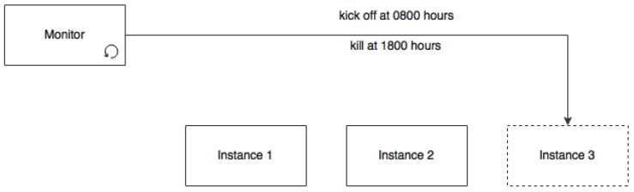
Scaling during specific time periods
Based on certain periods of the day, month, or year to handle seasonal or business peaks.
Example: auto-scale during office hours / downsize otherwise.
Notes:
For example, some services may experience a higher number of transactions during office hours and a considerably low number of transactions outside office hours.
In this case, during the day, services auto-scale to meet the demand and automatically downsize during the non-office hours:

Slide 19
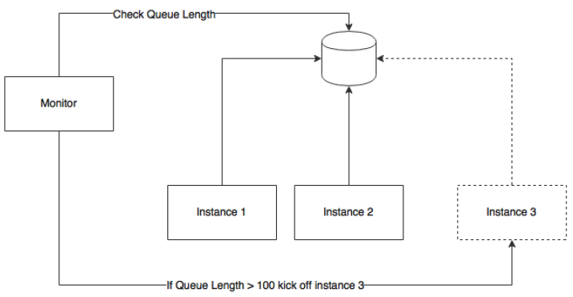
Scaling based on the message queue length
useful when the microservices are based on asynchronous messaging.
In this approach, new consumers are automatically added when the messages in the queue go beyond certain limits
This approach is based on the
competing consumer pattern.
Pool of instances is used to
consume messages.
Based on the message threshold,
new instances are added to consume
additional messages

Slide 20
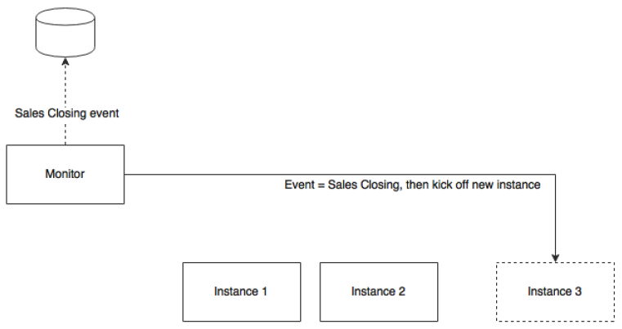
Scaling based on business parameters
adding instances is based on certain business parameters
Example: sales closing transactions
Notes:
for example, spinning up a new instance just before handling sales closing transactions. As soon as the monitoring service receives a preconfigured business event (such as sales closing minus 1 hour), a new instance will be brought up in anticipation of large volumes of transactions. This will provide fine-grained control on scaling based on business rules:

Slide 21
Predictive autoscaling
Predictive scaling is a new paradigm of autoscaling that is different from the traditional real-time metrics-based autoscaling
A prediction engine will take multiple inputs, such as historical information, current trends, and so on, to predict possible traffic patterns.
Predictive autoscaling helps:
avoid hardcoded rules and time windows
In the cases of sudden traffic spikes
Netflix Scryer is an example of such a system that can predict resource requirements in advance.

Slide 22
What’s next … ?
We need a component to monitor certain performance metrics and trigger autoscaling
We will call this component the life cycle manager
Responsible for detecting scaling requirements and adjusting the number of instances accordingly
Responsible for starting and shutting down instances dynamically

Slide 23
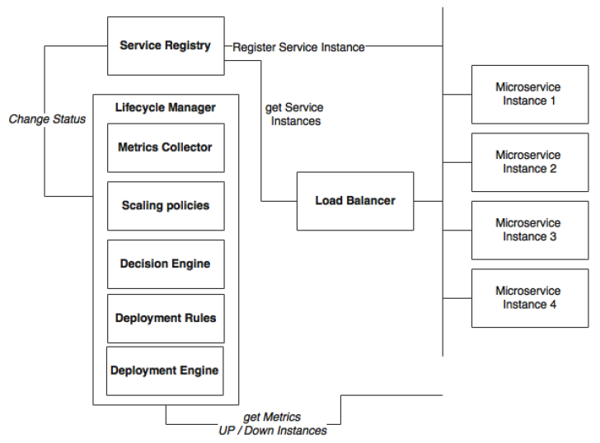
The capabilities required for an autoscaling system
Notes:
Microservices: These are sets of the up-and-running microservice instances that keep sending health and metrics information. Alternately, these services expose actuator endpoints for metrics collection. In the preceding diagram, these are represented as Microservice 1 through Microservice 4.
Service Registry: A service registry keeps track of all the services, their health states, their metadata, and their endpoint URI.
Load Balancer: This is a client-side load balancer that looks up the service registry to get up-to-date information about the available service instances.
Lifecycle Manager: The life cycle manger is responsible for autoscaling, which has the following subcomponents:
Metrics Collector: A metrics collection unit is responsible for collecting metrics from all service instances. The life cycle manager will aggregate the metrics. It may also keep a sliding time window. The metrics could be infrastructure-level metrics, such as CPU usage, or application-level metrics, such as transactions per minute.
Scaling policies: Scaling policies are nothing but sets of rules indicating when to scale up and scale down microservices—for example, 90% of CPU usage above 60% in a sliding window of 5 minutes.
Decision Engine: A decision engine is responsible for making decisions to scale up and scale down based on the aggregated metrics and scaling policies.
Deployment Rules: The deployment engine uses deployment rules to decide which parameters to consider when deploying services. For example, a service deployment constraint may say that the instance must be distributed across multiple availability regions or a 4 GB minimum of memory required for the service.
Deployment Engine: The deployment engine, based on the decisions of the decision engine, can start or stop microservice instances or update the registry by altering the health states of services. For example, it sets the health status as "out of service“ to take out a service temporarily.

Slide 24
Implementing a custom life cycle manager using Spring Boot
Here, we will use minimal implementation to understand autoscaling capabilities
In later chapters, we will enhance this implementation with containers and cluster management solutions
Ansible, Marathon, and Kubernetes are some of the tools useful in building this capability.

Slide 25
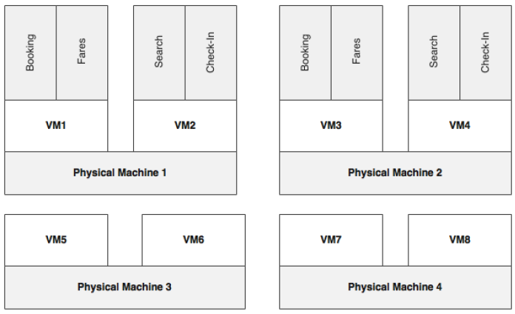
Understanding the deployment topology
Notes:
there are four physical machines. Eight VMs are created from four physical machines. Each physical machine is capable of hosting two VMs, and each VM is capable of running two Spring Boot instances, assuming that all services have the same resource requirements.
Four VMs, VM1 through VM4, are active and are used to handle traffic.
VM5 to VM8 are kept as reserve VMs to handle scalability. VM5 and VM6 can be used for any of the microservices and can also be switched between microservices based on scaling demands. Redundant services use VMs created from different physical machines to improve fault tolerance.

Slide 26
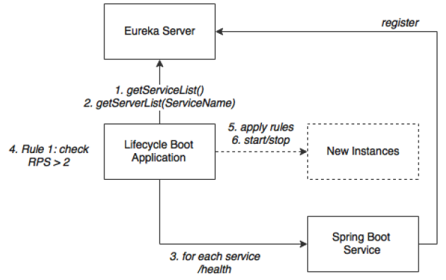
Objective … ?
Our objective is to scale out any services when there is increase in traffic flow using four VMs, VM5 through VM8, and scale down when there is not enough load.
The execution flow:
Notes:
Behind the scenes:
The Spring Boot service represents microservices such as Search, Book, Fares, and Check-in. Services at startup automatically register endpoint details to the Eureka registry. These services are actuator-enabled, so the life cycle manager can collect metrics from the actuator endpoints.
The life cycle manager service is nothing but another Spring Boot application. The life cycle manager has a metrics collector that runs a background job, periodically polls the Eureka server, and gets details of all the service instances. The metrics collector then invokes the actuator endpoints of each microservice registered in the Eureka registry to get the health and metrics information. In a real production scenario, a subscription approach for data collection is better.
With the collected metrics information, the life cycle manager executes a list of policies and derives decisions on whether to scale up or scale down instances. These decisions are either to start a new service instance of a particular type on a particular VM or to shut down a particular instance.
In the case of shutdown, it connects to the server using an actuator endpoint and calls the shutdown service to gracefully shut down an instance.
In the case of starting a new instance, the deployment engine of the life cycle manager uses the scaling rules and decides where to start the new instance and what parameters are to be used when starting the instance. Then, it connects to the respective VMs using SSH. Once connected, it executes a preinstalled script (or passes this script as a part of the execution) by passing the required constraints as a parameter. This script fetches the application library from a central Nexus repository in which the production binaries are kept and initiates it as a Spring Boot application. The port number is parameterized by the life cycle manager. SSH needs to be enabled on the
target machines

Slide 27
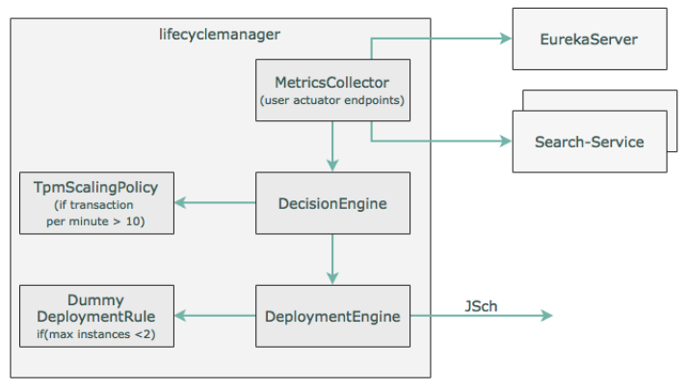
Flowchart of what to be done …?

Slide 28
For related code, check our pages [278-282] of the book

